Slide 1
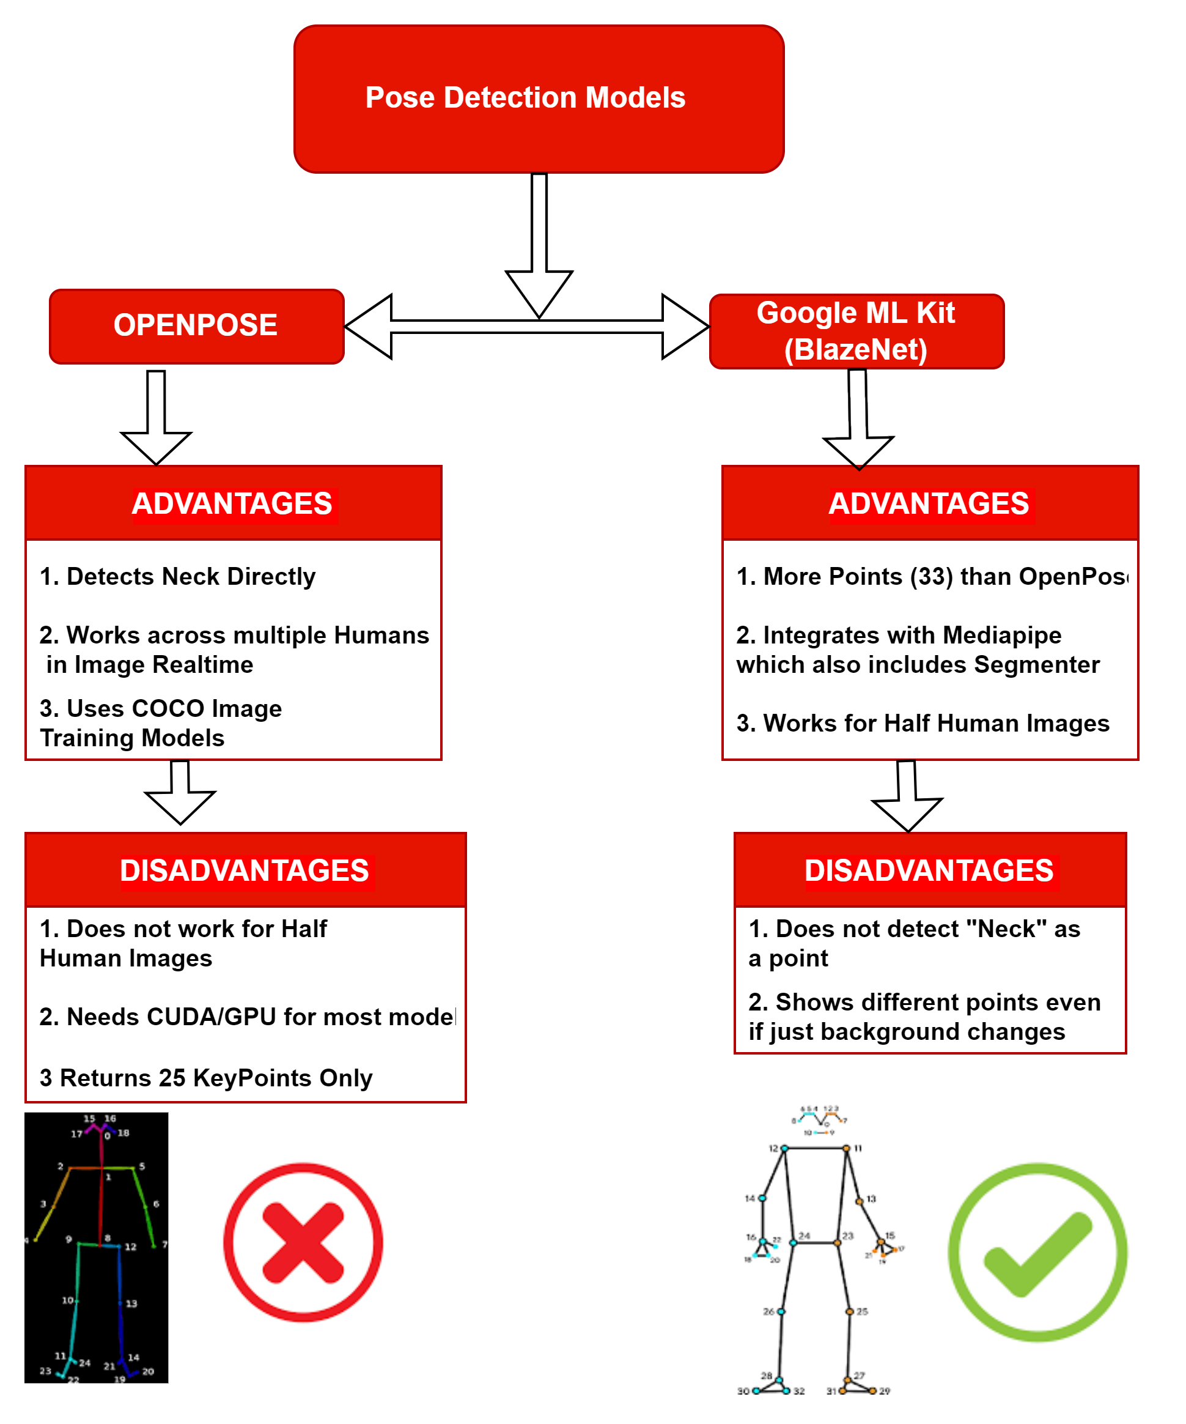
Virtual Try On Solutions- Necklace
Problem statement
Necklace Virtual Try On cannot be done using Face Detection or Face Segmentation Mechanisms.
In order to position a Necklace on a Human Image, we need to be able to determine the “thorax” and the relative Pose orientation of the Human Image to be able to accurately wrap and place the Necklace
OpenPose and BlazePose(via BlazeNet/MediaPipe) are 2 possible ML Models providing Solutions to the above Problem as they help detect or compute relative Pose Orientation Points
BlazePose(MediaPipe) has been chosen for this specific implementation as it allows us to suitably implement the same on “Selfie Images”

Slide 2
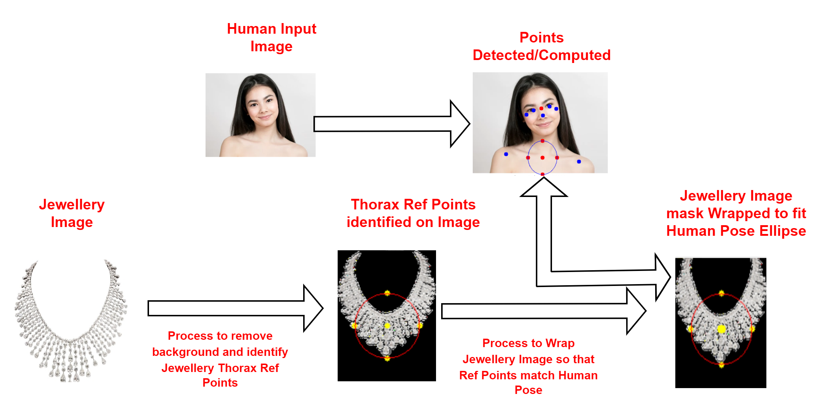
Virtual Try On – Necklace – Jewellery Image Processing
Necklace Image preparation
The Jewelry Image should clearly articulate relative thorax positioning points in the catalog image
Yellow Points below highlight the “Thorax Reference Points” as marked for the Jewelry Image.
Jewelry Image needs to be resized and wrapped to overlay on Human image
Thorax Relative Ref points are available along with Jewelry Image (yellow points in image below)

Slide 3
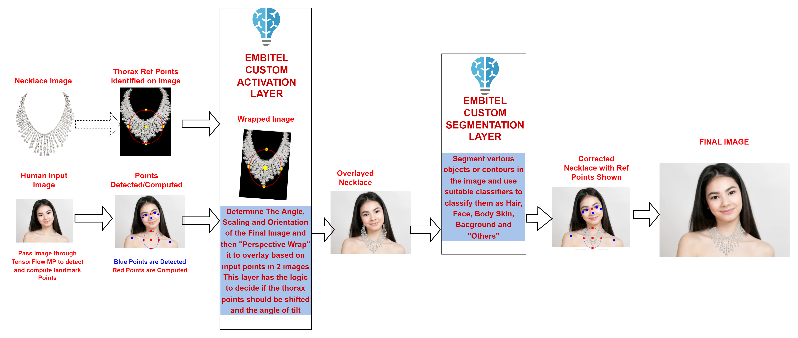
Virtual Try On – Necklace – Human Image Processing
HUMAN Image PROCESSING
Human Image Landmark Points for Necklace Overlay are detected via TF(BlazePose)
BLUE points are detected – RED are computed
Necklace Image is wrapped to fit on Human Reference Points (Yellow Points over Red Points)
Any outgrowth of the Necklace overlay is removed via Selfie Segmentation to regenerate the Face skin, Hair and Earrings

Slide 4
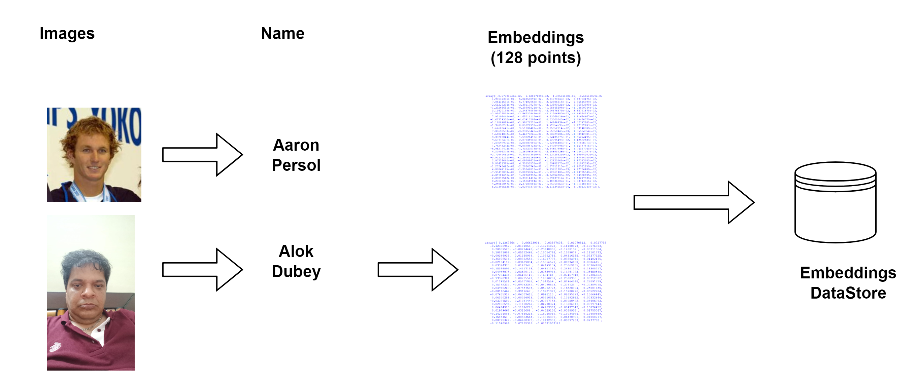
Face Recognition
Database Preparation PHASE - HOG Example:
Embeddings are n-dimensional "vectors" generally used to represent various predefined discreet features of input data. Based on the Model used (HOG/RCNN) and embedded array ( size is based on model) is generated for each input human face.
HOG – used in our case – generates an embedding map of 128 points/facial features based on input image
Take Images mapped to Name of person – and get embeddings for each image
Save the Embeddings => Name Map in a Database
We now have Embeddings of each input face mapped to a name

Slide 5
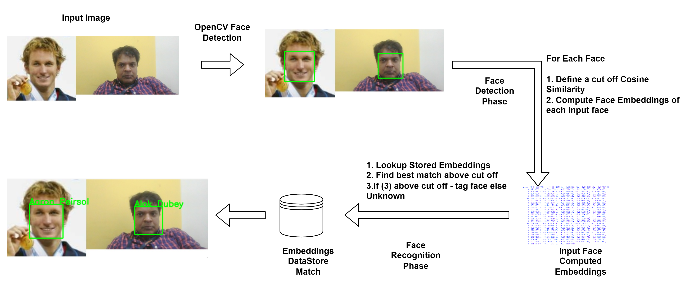
Face Recognition
Image Matching/Recognition
Detect Faces in given Input Image using any face detection module
Extract each detected face(green box area) as an image and compute its embeddings
Compute the embeddings of each face
Define the cosine Similarity cut off
Foreach face, find best cosine similarity match in Embeddings DataStore previously built
If cosine similarity below cut off tag the face else mark as Unknown

Slide 6
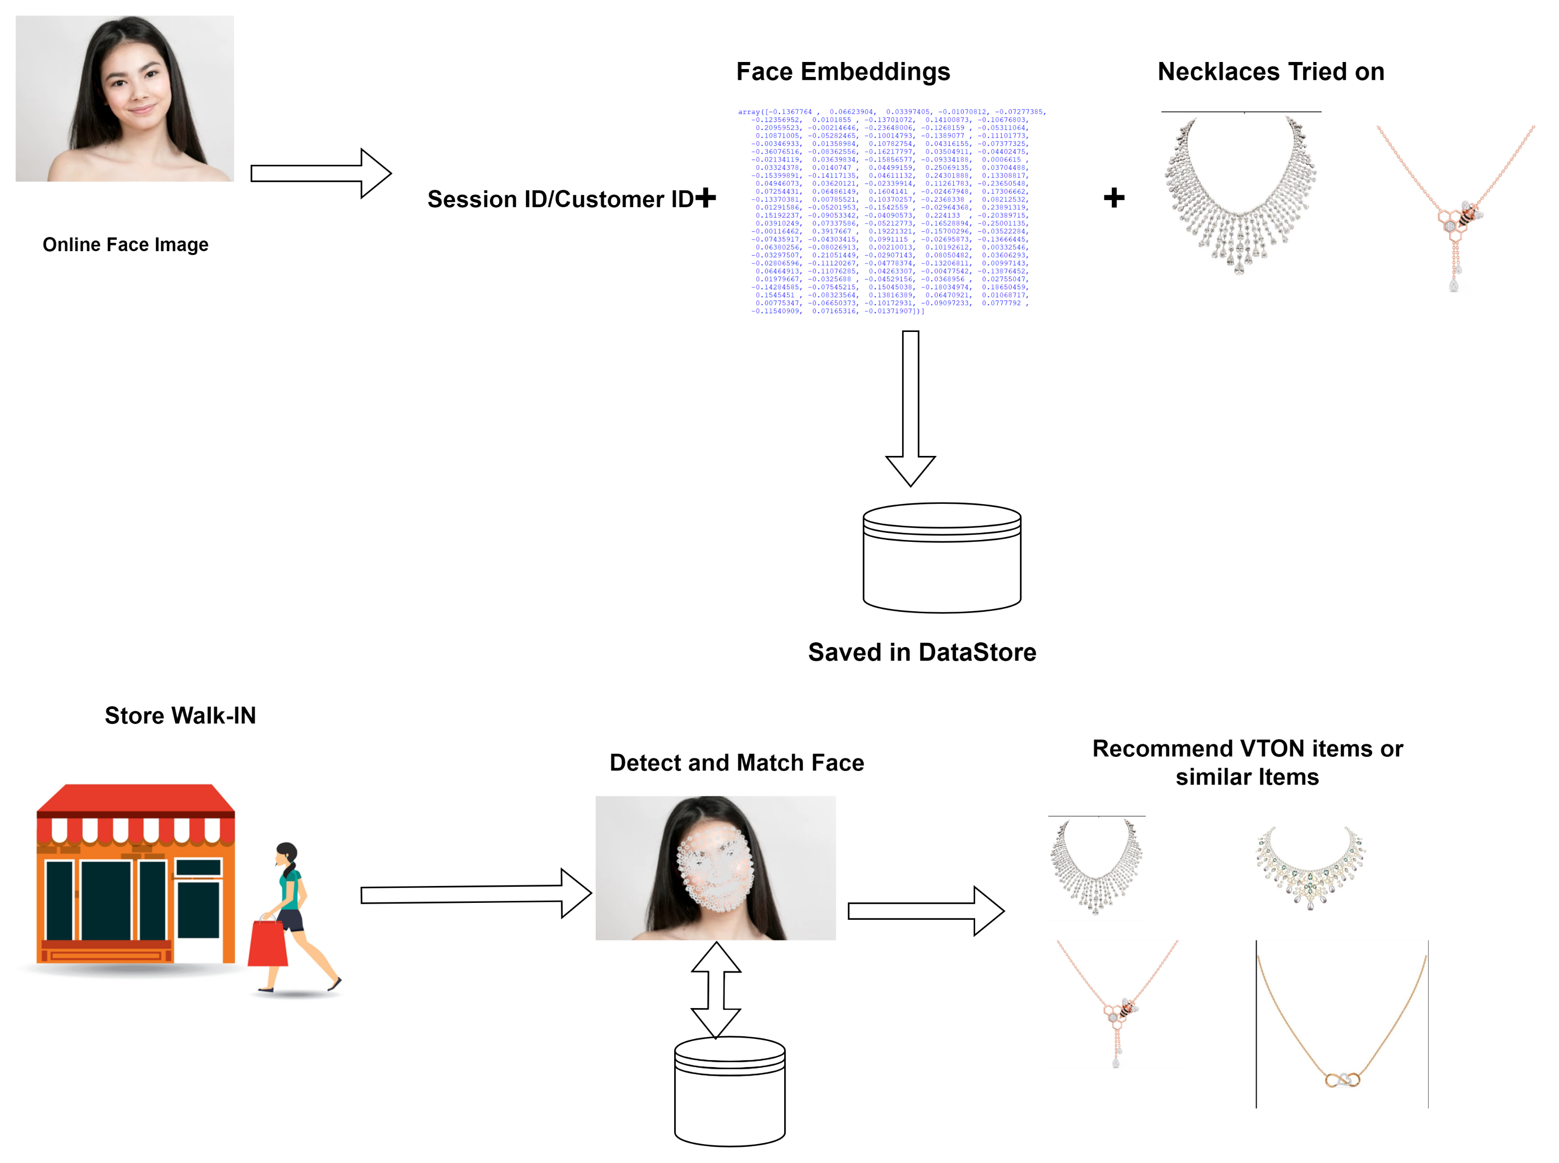
Face Recognition
Application – Online to store Walk-in Conversions
Each VTON client is given a guest ID/Session ID instead of a Name ,save the embeddings of the face tagged to the session ID
Also save the various Necklace/Jewellery Items seen by that guestId/CustomerId/SessionId
When user walks into store, we capture user Face and know the jewellery items he/she has tried out via VTON
The same or similar set of items can be displayed during walk-ins

